Slide 1
Concurrent Enrollment
How to use your enrollment report.

Slide 2
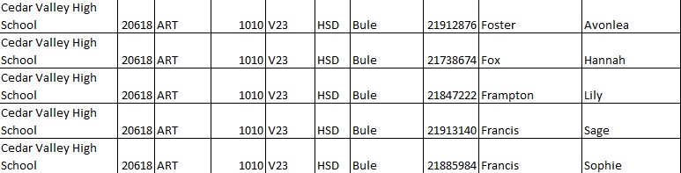
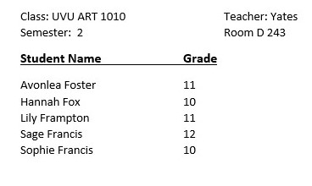
Live Interactive
Enrollment Report = Class Roster

Slide 3
Face to Face
Sort and send enrollment report to course instructors (teachers).
Have teachers check the “Face to Face” tab for students registered in their course.
Teacher informs student when they show as registered for the course on the enrollment report. This indicates that the student registration process for the course is complete.

Slide 4
Face to Face
Teachers check “Admitted not Registered” tab.
If teachers see a student from their class roster on the admitted not registered list, they need to inform the student that they have been admitted but have not registered for the actual course.
Help the student register or send the student to CE Coordinator for registration help.

Slide 5
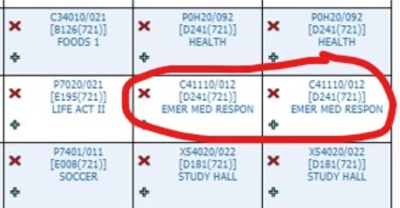
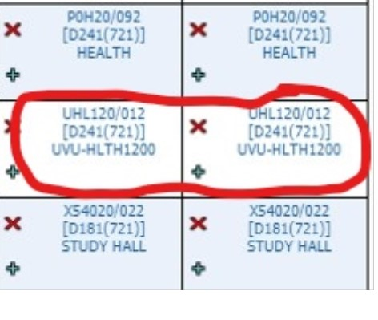
Face to Face

Slide 6
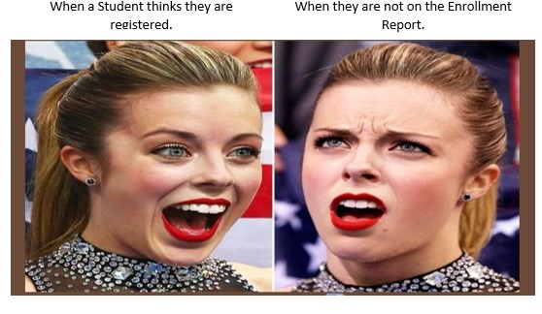
Enrollment Reports are Vital

